Slide 1
APHASIOLOGY
CLASSIFICATION OF APHASIA
DIFFERENT APHASIA SYNDROME
Ms Tanya Dash
2nd M.Sc(SLP)

Slide 2
DIFFERENT APHASIA SYNDROMES
Wernicke’s Aphasia/fluent
􀁹 Normal fluency, sometimes excessive(logorrhea)
􀁹 Impaired auditory comprehension
􀁹 Affected repetition
􀁹 Neologism, paraphasia, jargon speech( lexical retreival)
􀁹 Usually normal prosody and articulation
􀁹 Affected reading and writing

Slide 3
Broca’s aphasia
􀁹 Nonfluent effortful speech, slow rate, flat melody
􀁹 Limited word output /telegraphic speech
􀁹 Agrammatic
􀁹 Impaired repetition
􀁹 Affected naming, reading, writing(often hemiparesis)
􀁹 Better auditory comprehension

Slide 4
Conduction Aphasia
􀁹 Fluent, less than Wernicke’s
􀁹 Minor defect….auditory comprehension
􀁹 Repetition impaired
􀁹 Phonemic paraphasia
􀁹 Usually paresis of face and body

Slide 5
Transcortical sensory
􀁹 Fluent, paraphasic speech
􀁹 Global paraphasia
􀁹 Intact repetition(occassional echolalia)
􀁹 Impaired naming

Slide 6
Transcortical Motor
􀁹 Nonfluent speech
􀁹 Global and phonemic paraphasia
􀁹 Intact repetition(echolalia)
􀁹 Affected auditory comprehension, not
severe

Slide 7
Anomia
􀁹 Naming difficulties as a residual symptom.
􀁹 Normal fluent output with occasional interruptions as the patient pauses to find the next correct word.
􀁹 Circumlocution.
􀁹 Anomia does not have clear localizing significance.

Slide 8
Pure word deafness
􀁹 Specific deficit of perception of spoken language, other auditory perception is intact.
􀁹 Writing is normal, reading may be impaired.
􀁹 Lesion of the primary auditory cortex contiguous to Wernicke's area produces this syndrome.

Slide 9
Agraphia (pure)
Usually without other language disturbances.
􀁹Well‐formed letters but characteristic spelling errors.
􀁹 Lesion of the second frontal convolution (Exner's area), superior parietal lobule and perisylvian areas produce this syndrome

Slide 10
Alexia:
􀁹 Cannot read, other language functions are intact
􀁹 Lesion of the left occipital lobe that also includes the pathways connecting the visual perceptual areas
􀁹 The patient comprehends auditory information and can write and speak normally

Slide 11
Global aphasia
Deficits in
􀁹 Expression
􀁹 Comprehension
􀁹 Reading & writing
􀁹 Naming
􀁹 Ability to repeat

Slide 12
OSTON
 | Comprehe-nsion | Verbal expression | Repetition | Other names
Broca | Mild to moderate | Aggramatic | Agrammatic but better | Motor, expressive,syntactic
Global | Severe | Minimal stereotypic | Equally impaired
Transcortical motor | Mild to moderate | Nonfluent | Less impaired | Dynamic
Wernicke | Severe | Parahasic (jargon) | Equally impaired | Sensory, receptive, semantic
Conduction | Mild to moderate | Phonemic paraphasia | More impaired
Anomia | Mild | Circumlocution | Spared | Amnesia, nominal
Transcortical sensory | Severe | Paraphasic | Less impaired (echolalia) | Isolation syndrome

Slide 13
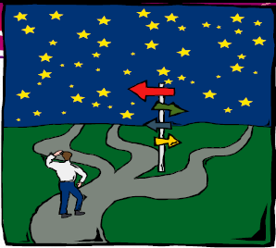
Classification of aphasia

Slide 14
Classification…..
As many patient====clinical forms even
Brookshire (1983) ----- type of aphasia is probably is a subject characteristics most likely to be influenced by the beliefs, biases, and opinions of the investigator.
􀁹 Classification is a sorting system…
􀁹 Each school of thought has their own classification system and thus there are more than one right way to classify any phenomenon

Slide 15
This has led to terminological CONFUSION
These confusions appear to be related to various factor
    Indifferent usage of various terms to refer to the same phenomena
    The same label may be employed, according to different usage, to refer to different clinical phenomena
    Semantic ambivalence (coexistence of opposing meaning)

Slide 16
CLASSIFICATIONS ARE A NECESSARY EVIL..
DAMASIO 1998
The deversity which we see as student—reflects the evolution of the science of aphasia and the conflicts are more apparent the systems derive from different point of view.
Opponents of classification----inadequate in capturing the complexity and severity of the given patient’s language impairment.
Supporter: consider classification as an efficient method for describing symptoms that can be used to enhance communication among professionals.

Slide 17
Classifications are based on:
  Clinical =By symptoms
  By theories of how the brain works
    Connectionist/Locationist
    Holistic
  anatomoclinical
  Physiological
  Psycholinguistic
  Anatomical

Slide 18
PROS AND CONS OF CLASSIFICATION
Different aphasics almost never share the same set of symptoms (Benson&Ardila)
  Variations “are so plentiful as to be the rule”
  A single type of aphasia may have distinctly different loci of pathology
    Conduction aphasia
      Parietal
      Temporal
    Transcortical motor aphasia
Differing interpretations of sets of symptoms
Different approaches to classification

Slide 19
MAIN ARGUMENTS FOR CLASSIFYING APHASIA INTO TYPES:
Different aphasia types have different cerebral site of lesion
Different brain areas control different language functions
Different lesions sites produce distinctively different syndromes
Treatment techniques vary with typology
Prognostic implications may vary with different syndrome.

Slide 20
MAIN ARGUMENTS AGAINST CLASSIFICATION
Brain functions as an integrated unit controlling language
Localization of site of lesion is not same as localization of language function
Different site of lesion effect most if not all language modalities/ functions
Variations in fluency may be due to variations in severity
Longitudinal studies show that aphasic patients who appear different may appear similar later during the course of recovery

Slide 21
WHY SO MUCH OF VARIATION IN SYMPTOMS
Difference in areas of brain damage
Difference in kinds of brain damage
  Strokes vs trauma vs infection vs tumors
  Different kinds of stroke
Anatomical variation among people
  Differing cortical structures
  Differences in vascular anatomy
Difference in location of cortical functions

Slide 22
From aphemia to aphasia

Slide 23
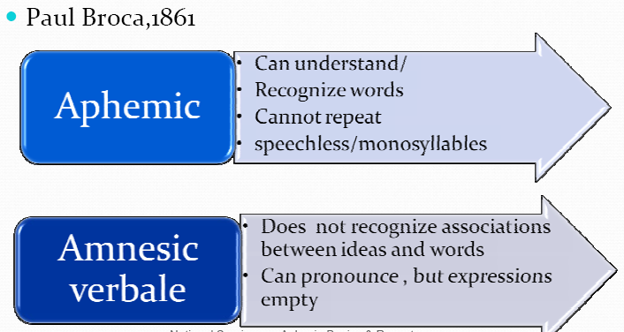

Slide 24
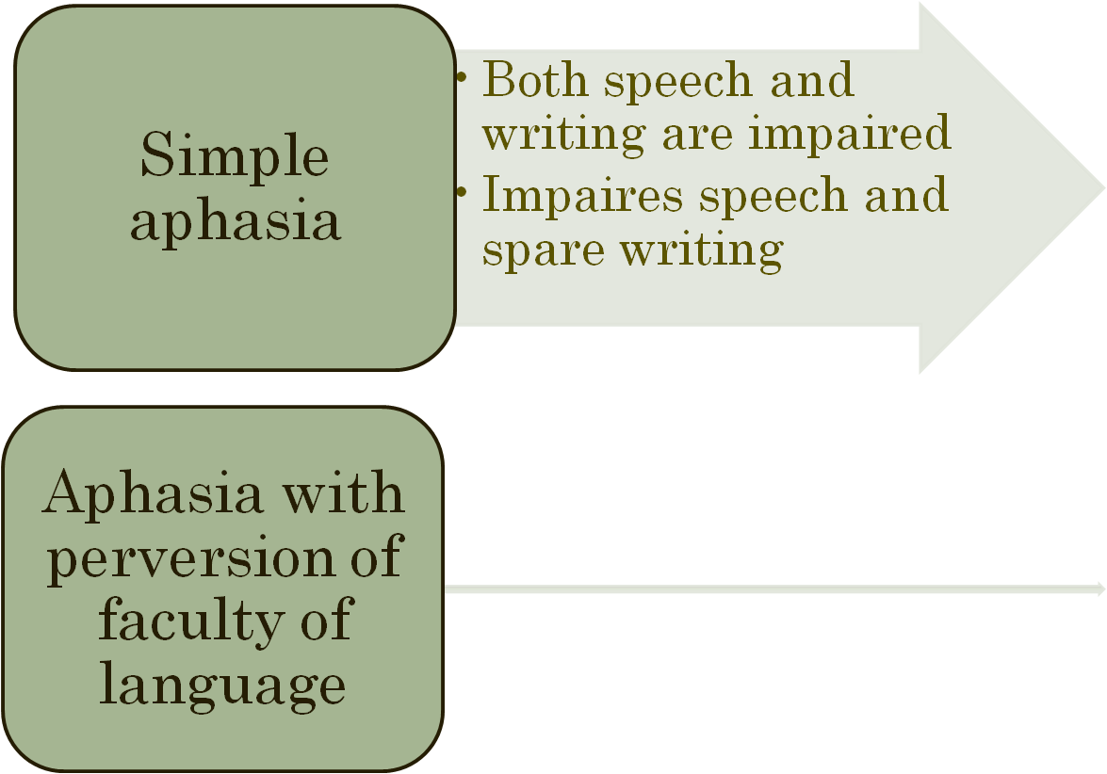
BAILLAREGER (1865)

Slide 25
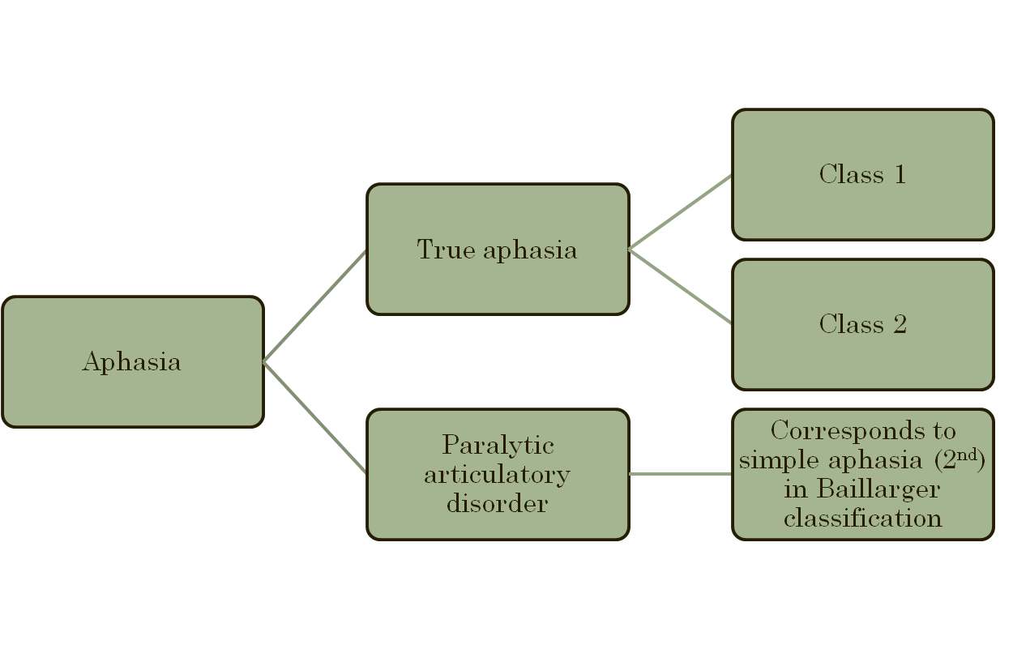
JACKSON (1868) SIMILAR TO BAILLARGER

Slide 26
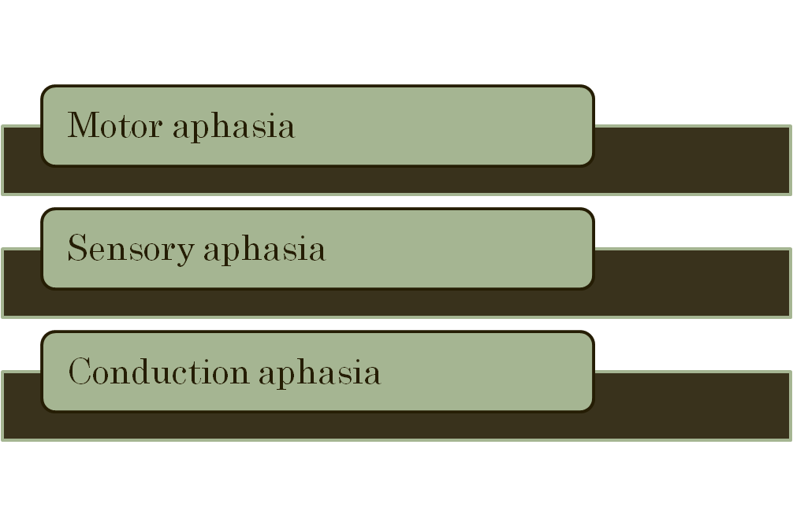
WERNICKE (1874)

Slide 27
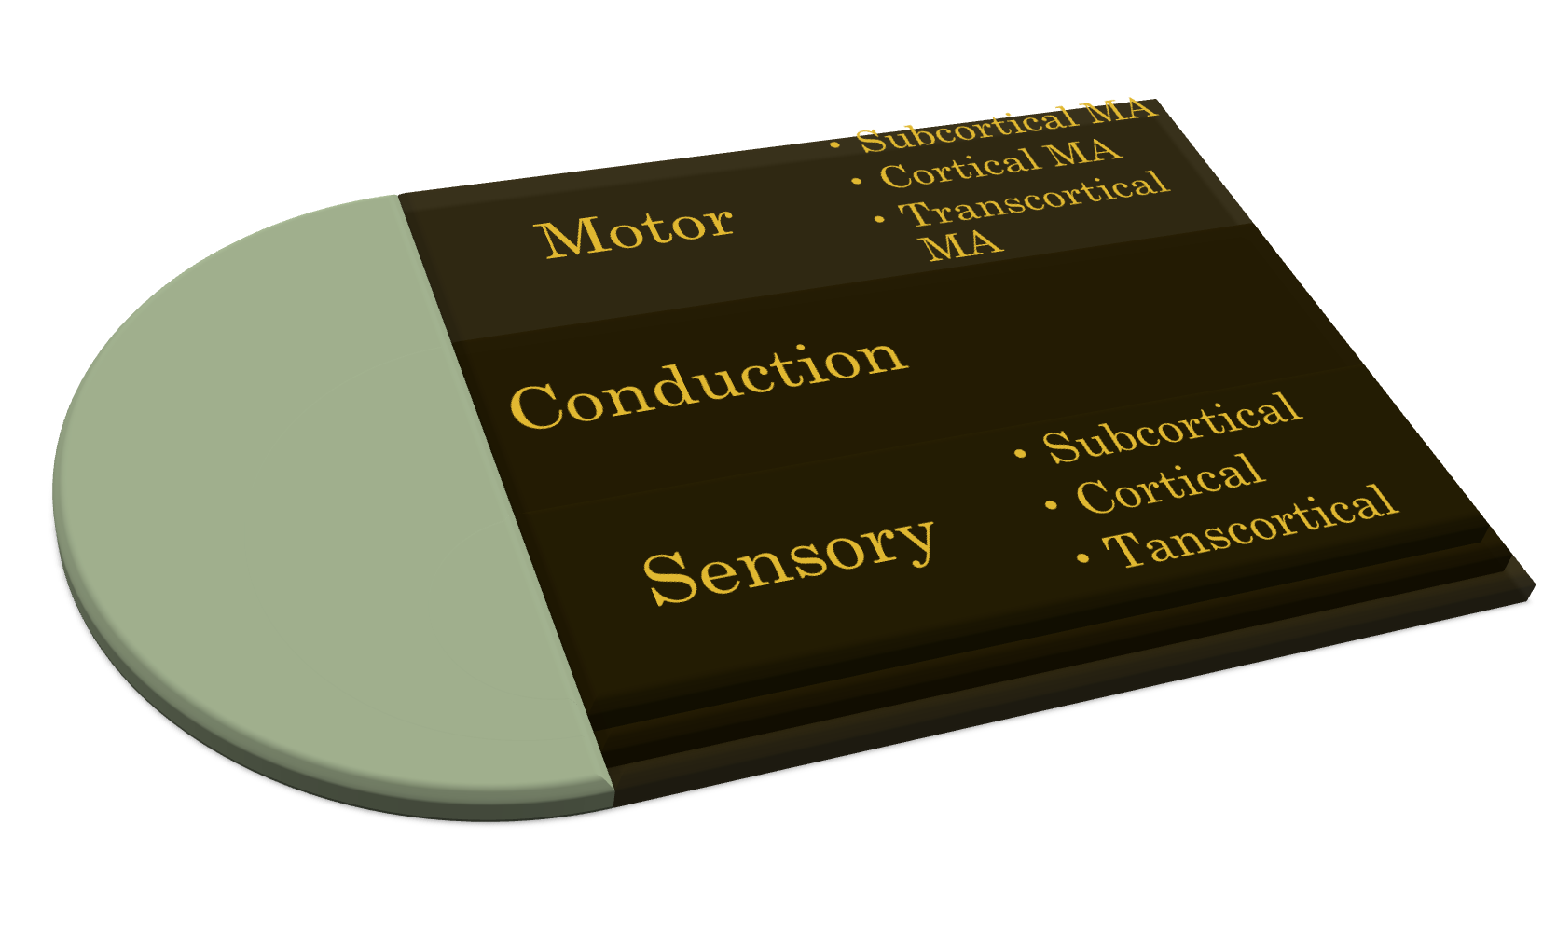
LICHTEIM (1844) AND WERNICKE (1885-1886)

Slide 28
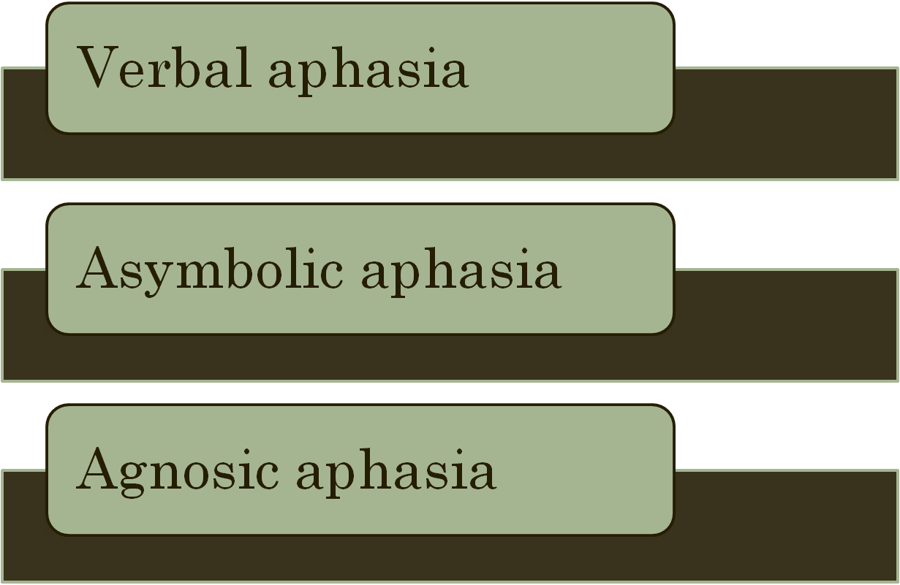
FREUD (1891)

Slide 29
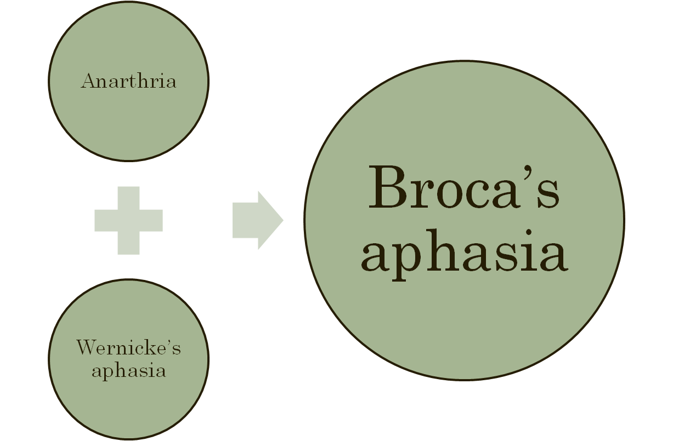
PIERRE MARIE (1906)

Slide 30
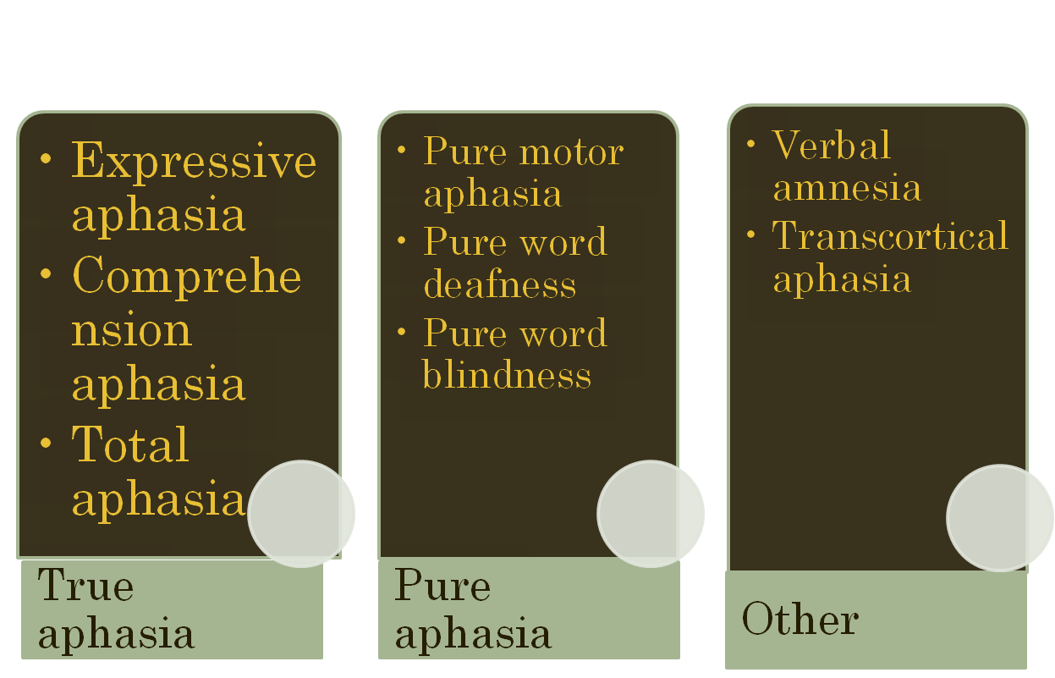
DEJERINE (1914)

Slide 31
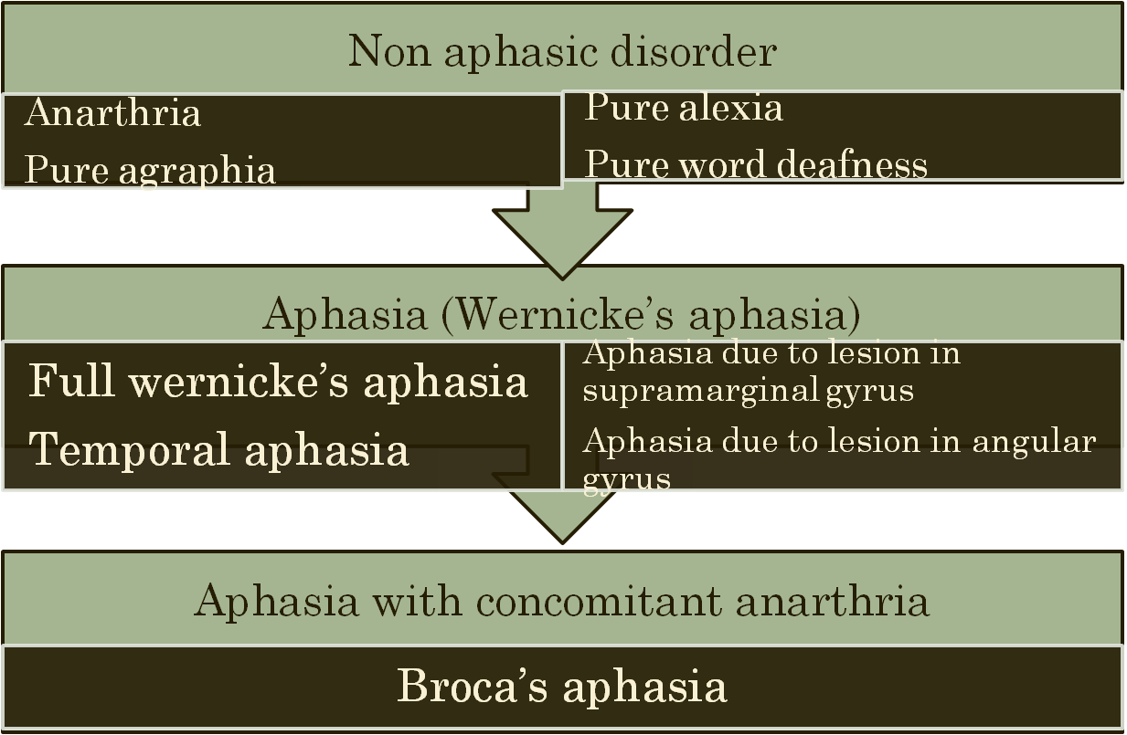
FOIX (1917)

Slide 32
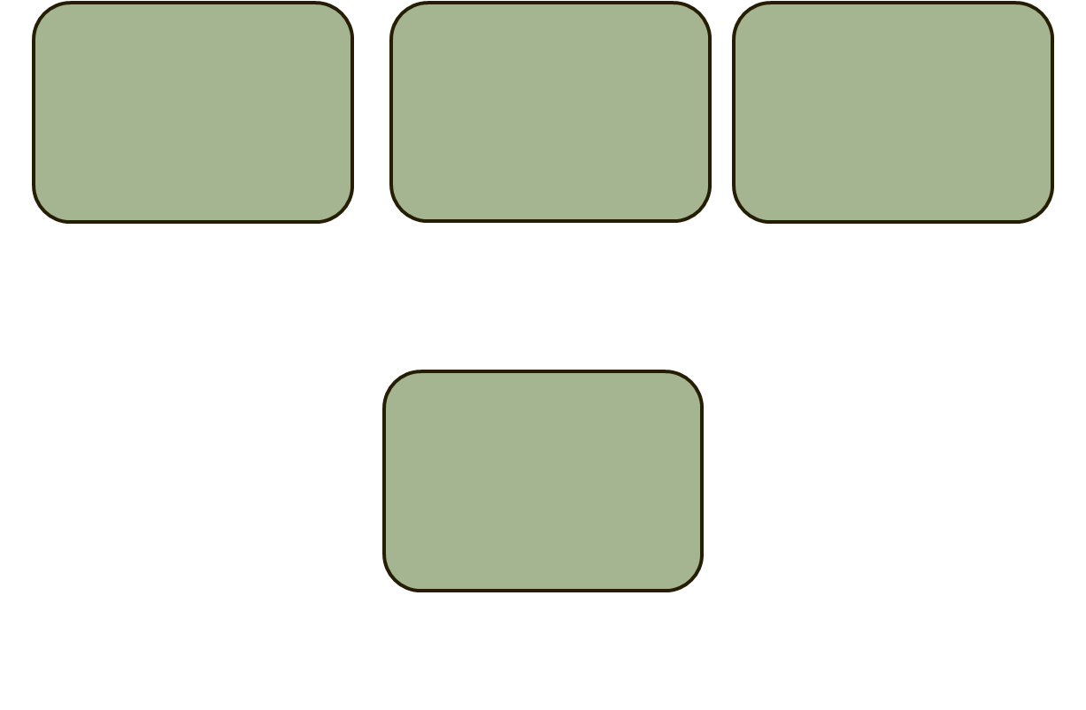
HEAD (1926)
Verbal aphasia
Syntactic aphasia
Nominal aphasia
Semantic aphasia

Slide 33
GOLDSTEIN (1948)
Aphasia from predominant impairment of instrumentalities of language
  Peripheral motor aphasia
  Motor agraphia
  Peripheral sensory aphasia
  Primary alexia
Aphasia linked to a dedifferentiation of inner language= central aphasia
Aphasia linked to a disturbance of abstract attitude= amnesia aphasia
Impairment in instrumentalities of language+ abstract attitude+ dedifferentiation of inner language
  Central motor aphasia
  Central sensory aphasia
Aphasia from anomalies of non-linguistic mental processes
  Transcortical motor
  Tanscortical sensory
  Mixed

Slide 34
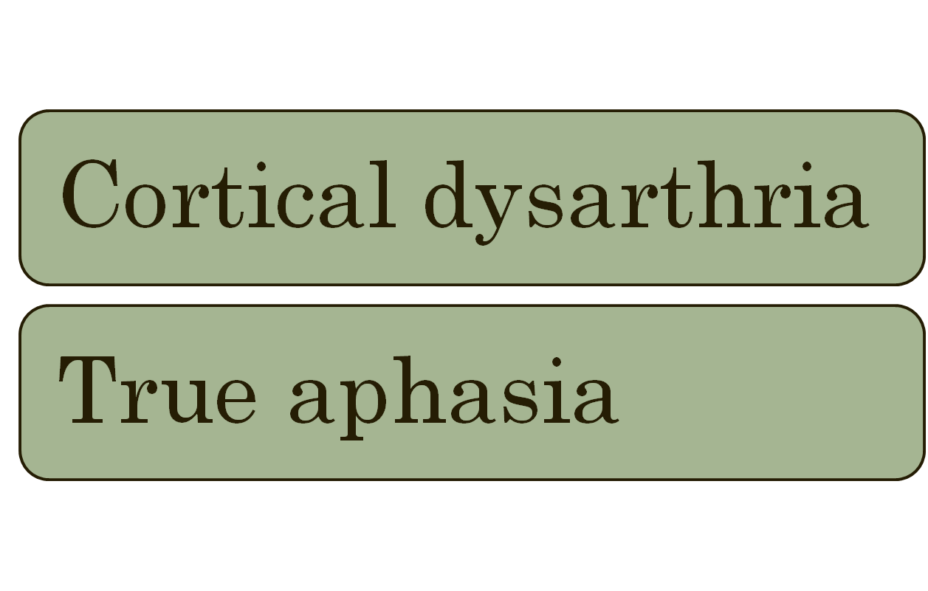
BAY (1964)

Slide 35
Luria(1964)
Jakobson (1956 and 1964)

Slide 36
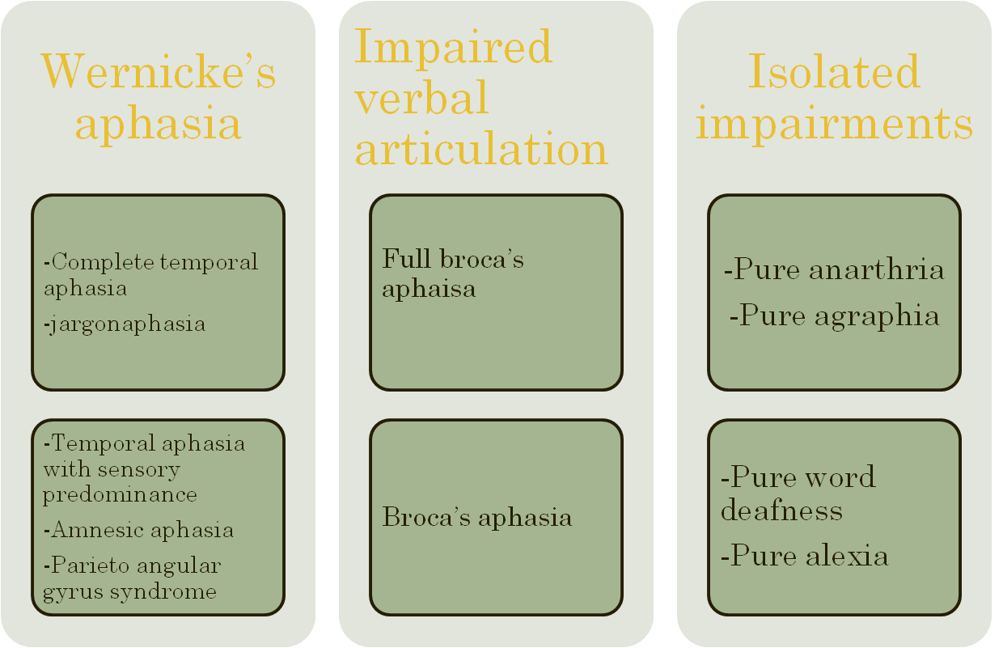
ALAJOUANINE (1968)

Slide 37
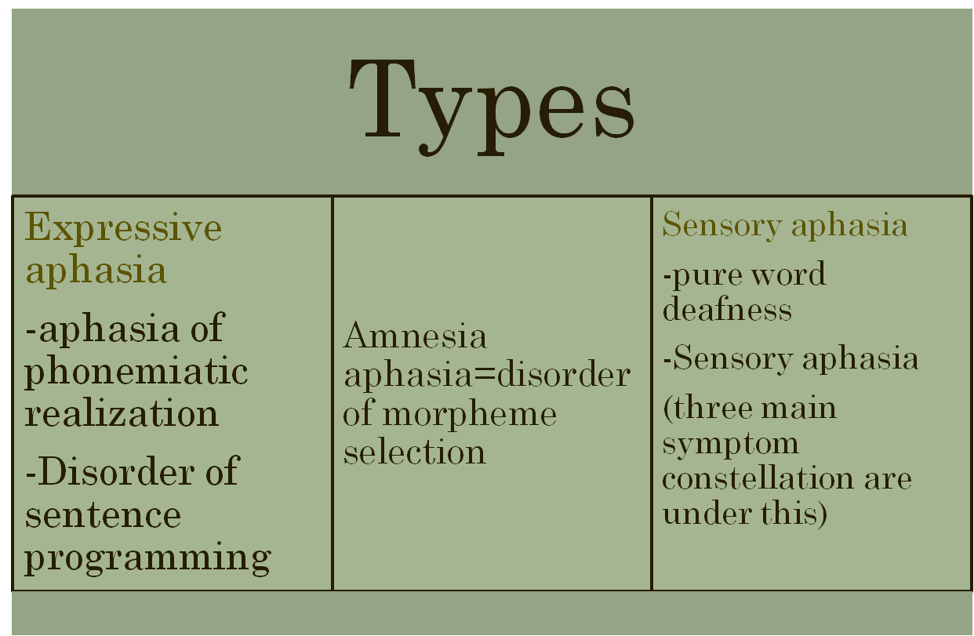
HECAEN (1972)

Slide 38
GOODGLASS (1972)
Broca’s aphasia
Wernicke’s aphasia
Anomic aphasia
Conduction aphasia
Transcortical sensory aphasia
Transcortical motor aphasia
Alexia with agraphia
Pure aphasia
  Pure alexia
  Pure word deafness
  Pure agraphia
  Aphemia

Slide 39
DAMASIO’S CLASSIFICATION (1998)
Wernicke’s aphasia
Broca’s aphasia
Conduction aphasia
Transcortical sensory aphasia
Transcortical motor aphasia
Global aphasia
Anomic aphasia
Alexia
Pure word deafness
Atypical aphasias

Slide 40
LINGUISTIC APPROACHES TO CLASSIFICATION

Slide 41
Dichotomization
  Predominantly expressive
  Predominantly receptive
  amnesic
Luris’s system
Jakobson’s
Goodglass and Kaplan’s
Hacaen and Dubois’s
Brown’s
Lecours
Aphasia is one dimensional and
can properly only be classified
by severity and concomitant factor

Slide 42
Apart from terminological modification, there was an attempt towards==OBJECTIFY
Various methods
      Ratio of nouns and pronouns-------Wepman and Jones 1966
      Phrase length-------------------Goodglass et al 1964
      9 measures----------Howes 1967, they categorized aphasia into TYPE A AND TYPE B

Slide 43
LURIA’S CLASSIFICATION (1964)
Sensory aphasia
Acoustic-amnestic aphasia
Afferent motor aphasia
Efferent motor aphasia
Semantic aphasia
Dynamic aphasia

Slide 44
JAKOBSON’S CHARACTERIZATION OF LURIA’S SIX FORMS OF APHASIA
 | Efferent motor aphasia | Dynamic aphasia | Semantiaphasia | Sensory aphasia | Acoustic amnestic aphasia | Afferent motor aphasia
Encoding | + | + |  |  |  | +
Decoding |  |  | + | + | +
Sequencing | + | + |  |  | +
Concurrence |  |  | + | + |  | +
Disintegratin | + |  |  | +
limitation |  | + | +

Slide 46
de Saussure’s 2 linguistic plane
Phonological plane
Semiological plane
Phoneme
stock
lexicon
Selection axis
phoneme
chain
word
text
Combination axis

Slide 47
Sabouraud’s classification
Language can be represented by a dual system coordinates
Broca’s aphasia=disturbance in horizontal axes
Wernicke’s aphasia=disturbance in vertical axes
These 2 types can further be distinguished by particular plane which is disturbed

Slide 48
According to this typology
Semiological Broca’s aphasia
Phonological Broca’s aphasia
Semiological Wernicke’s aphasia
Phonological Wernicke’s aphasia

Slide 49
JAKOBSON’S ANALYSIS USED TWO AXES OF SELECTION AND COMBINATION
2 types:
Disorder of selection
Disorder of combination
Selection is an internal relation, range of possibilities are not made overt
Combination is overt, an external relation of contiguity

Slide 50
To avoid undesirable implication of these terms : Jakobson introduced- encoding and decoding
Encoding aphasia: while encoding speaker makes selection of element before combining=process of combination impaired
Decoding aphasia: while comprehending speech, 1st we grasp the whole and then identify the constituent=process of selection is impaired

Slide 51
2 other dichotomies:
Disintegration and limitations
Sequence and concurrence
Disorder of encoding
Efferent motor Afferent motor Dynamic
Disorder of decoding
Acoustic-amnesic acoustic agnosic semantic

Slide 52
Disorder of disintegration
Efferent motor Sensory
Disorder of limitation
Dynamic semantic
Disorder of sequencing
Efferent motor Dynamic Acoustic amnesic
Disorder of concurrence
Afferent motor Semantic Acoustic agnosic

Slide 53
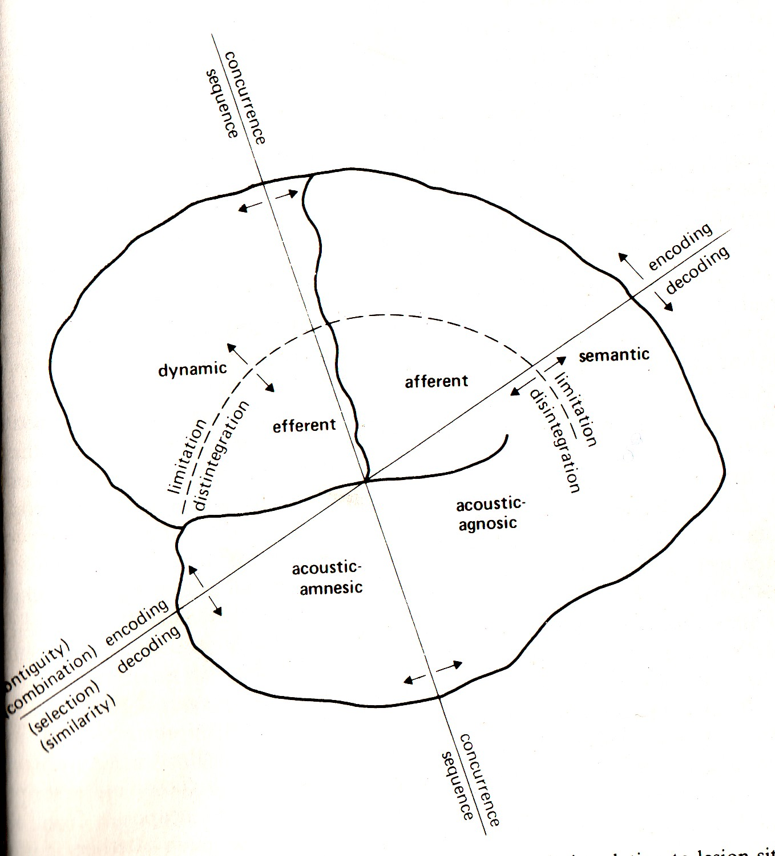

Slide 54
All the best

